Slide 1
Guelph/Eramosa 2021 Draft Budget Presentation
Tuesday, December 15, 2020

Slide 2
Our Township
Area of 292 km² and provide services to over 13,000 residents
The Township is responsible for maintaining:
225 km. of roads and 29 bridge and culvert structures
Fire protection and rescue services
82 ha. of open space
14 parks that include 11 play structures, 1 splash pad, 1 skate park, 1 leash free dog park, 3 tennis courts and 7 volunteer ice rinks
7 community facilities
12 sports fields
6.6 km. of trails
Guelph/Eramosa employs 40 full time, 40 volunteer fire fighters, 19 part time/seasonal, 8 summer students & 16 casual staff
Guelph/Eramosa is one of seven municipalities in the County of Wellington

Slide 3
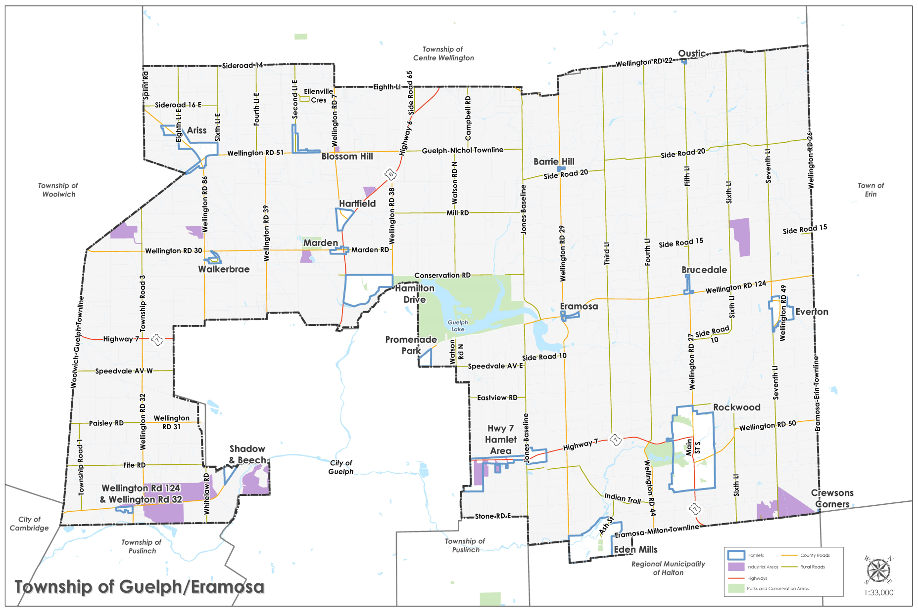
Our Township

Slide 4
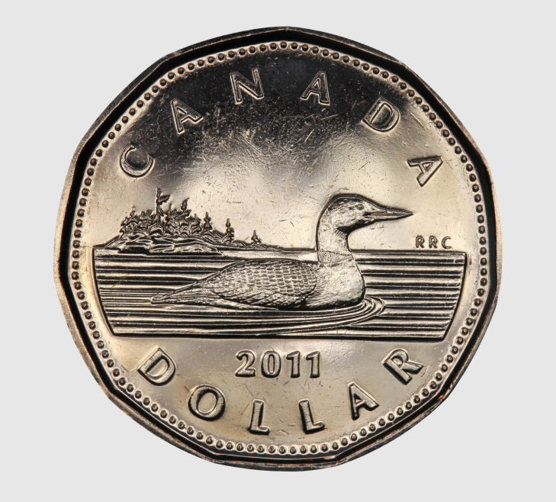
Guelph/Eramosa is Only a Portion of the Municipal Tax Bill
For every residential property tax dollar you pay, Guelph/Eramosa receives only 24 cents
Province
(Education)
20 cents
Township
24 cents
County
56 cents

Slide 5
Departments & Functions
Administration
Council
CAO/Human Resources
Legislative Services (Clerk’s) Department
Finance Department
Protection to Persons & Property
Fire & Emergency
By-law Enforcement & Property Standards
GRCA
Building
Emergency Management
Canine Control
Livestock

Slide 6
Departments & Functions
Public Works
Roads & Transportation Services
Environmental Services
Water, Wastewater and Source Water Protection
Parks & Recreation
Facilities and Parks - Rockwood Cemetery
Recreational Programming
Planning
Committee of Adjustment - Economic Development
Planning Services - Heritage Committee

Slide 7
Fiscal Environment – 2021 Budget Impact
Corporate wide costs pressures:
Insurance Premium – 21.14% Increase
Health Benefits – 4.8% Increase
Wages/Salary – 0.5% Cost of Living Adjustment for Staff
COVID-19 Pandemic
Lost revenue due to facility capacity restrictions and cancellations
Additional cleaning costs for safe restart and risk mitigation
Safe Restart Funding from the Province of Ontario

Slide 8
Fiscal Environment – 2021 Budget Impact
Additional Impacts and Considerations
2020 Ontario Municipal Partnership Fund (OMPF) allocation decreased by $6,000 to $488,200
Increased costs for fire protection service contract
Shared service contract for full time by-law officer
1.69 % increase in growth related assessment
No changes to the current value assessment due to reassessment

Slide 9
Fiscal Environment – 2021 Budget Impact
Grant Funding
Ontario Community Infrastructure Funding (OCIF)
2021 allocation $445,088
Federal Gas Tax Funding
2020 Gas Tax Funding $389,942
2021 Gas Tax Funding $407,667

Slide 10
Fiscal Environment – 2021 Budget Impact
Ontario Safe Restart Grant
Introduced in 2020

Slide 11
Other 2021 Operational Budget Impacts
Long Term Borrowing and Debt Repayment
No new debt scheduled to be issued in 2021
Annual debt servicing costs will top out at $708,697
$468,321 tax supported
$240,376 user fees and development charge supported
Principal and Interest Payments due over the next five years:
2021 - $ 708,697
2022 - $ 697,636
2023 - $ 378,409
2024 - $ 376,993
2025 - $ 377,149

Slide 12
2021 Total Spending
Type of Spending | Total Spending ($)
Water and Wastewater Operating, Long Term Debt Repayment and Capital Expenditures not funded through taxation | $4.2 million
Operating Expenditures (annual spending to provide services and perform operations) | $8.3 million
Capital Expenditures (planned spending to acquire or maintain a capital asset) | $3.1 million
Transfers to Reserves | $2.2 million
Long Term Debt Repayment | $0.5 million
TOTAL | $18.3 million

Slide 13
Sources of Revenue
Source of revenue | Total
Water and Wastewater (user rates and development charges) | $4.2 million
Non tax revenue i.e. user fees, grants, financing, development charges & reserves | $6.9 million
Revenue from property taxes | $7.2 million
TOTAL | $18.3 million

Slide 14
How Will We Fund the 2021 Budget?
Property Taxes 39.2%
Non-Tax Revenue
38%
Water &
Wastewater
Rates
22.8%

Slide 15
Property Taxes Provide Resources to Deliver Services
Parks & Recreation
18%
Planning
2%
Public Works*
46%
Protection to Persons
and Property
21%
* Excludes Water/Wastewater, which is funded through user rates
General Government
13%
Notes:
Breakdown essentially unchanged from last year.

Slide 16
Managing Our Assets
The Township has over $151 million invested in municipal assets including infrastructure, facilities, vehicles and equipment
The Township is committed to building financial sustainability for the maintenance, renewal and replacement of the municipal infrastructure
The 2021 budget includes $269,000 dedicated to infrastructure renewal as a proactive infrastructure maintenance strategy to support the rehabilitation and renewal of municipal roads and bridges

Slide 17
Capital Highlights

Slide 18
Capital Spending By Department
Department | Total 2021 Spending ($) | Source of Funding
General Administration | $255,540 | Reserves, gas tax funding
Fire and Emergency Services | $32,000 | Reserves
Public Works | $2,495,000 | Reserves, gas tax funding, OCIF funding, development charges, shared service agreement
Parks and Recreation | $300,500 | Reserves
Water | $955,000 | Capital and life cycle reserve funds and development charges
Wastewater | $62,000 | Reserve funds and development charges
TOTAL | $4,100,040

Slide 19
General Administration
2021 Capital Budget
Asset Management Plan
$100,000 for the Township to update the Asset Management Plan to include all municipal assets in accordance with the Infrastructure for Jobs and Prosperity Act 2015 introduced by the Province of Ontario.
Telephone System Upgrades
$21,000 to upgrade the telephone system.
Online Interactive Planning Map and Property Database
$10,000 to develop an online, integrated interactive mapping program.

Slide 20
General Administration
2021 Capital Budget
Background Study – Community Benefit Charge
$20,000 for consulting services to implement the new Community Benefit Charge introduced by the Province of Ontario in Bill 108 More Homes, More Choice-Ontario’s Housing Supply Action Plan.
IT Infrastructure Improvements
$104,540 to upgrade server hardware, network equipment, software, licensing and installation.

Slide 21
Fire and Emergency Services Capital Highlights

Slide 22
Fire and Emergency Services
Proposed budget includes:
Bunker Gear
$10,500 for bunker gear
Pagers
$5,000 bi-annual replacement of pagers and batteries
Emergency Reporting Software
$3,500 for records management software
Internet Upgrade
$13,000 for fiber optic high speed internet

Slide 23
Public Works Capital Highlights

Slide 24
Public Works
Proposed budget includes:
Woolwich Guelph Townline surface treatment (Lerch To Chilligo)
Township Road 3 resurfacing (Highway 7 to Wellington Road 30)
Woolwich Guelph Townline resurfacing (Chilligo to Highway 7)
Sixth Line box culvert replacement
Backhoe replacement
Fleet vehicle replacement
Public Works new fleet vehicle

Slide 25
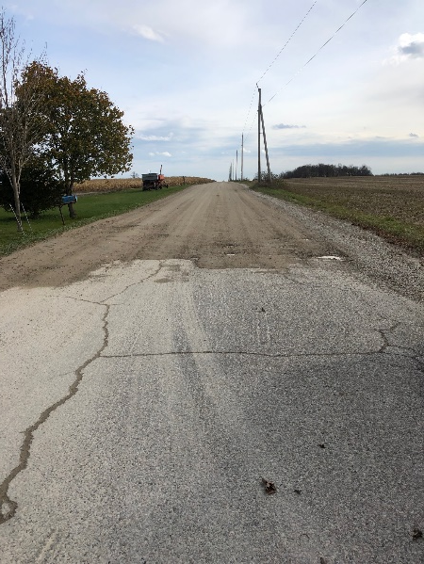
Public Works
Woolwich/Guelph Townline Surface Treatment
Existing surface gravel road of approx. 2 km from Lerch Road to Chilligo Road in Woolwich.
Woolwich driven multiyear gravel conversion project. Road section maintained by Guelph/Eramosa and will reduce grader travel requirements.
Double (DST) and Single (SST) Surface Treatment Multiyear Program
2020 gravel and ditching completed
2021 – DST Township cost $60,000
2022 – SST
Funding from Reserves

Slide 26
Public Works
Township Road 3 Reconstruction
Existing asphalt road
Approx. 2.9 km from Highway 7 to Wellington Road 30
Higher volume road with poor pavement condition
Current project in 10 year plan
Proposed vertical realignment and
100 mm hot mix surfacing
Estimated cost: $1,587,000
Funding from Gas Tax and Reserves

Slide 27
Public Works
Woolwich/Guelph Townline Resurfacing
(Chilligo to Highway 7)
Existing asphalt road of approx. 1.4 km from Chilligo Road in Woolwich to Highway 7
Current Project in 10 Year Plan
Coordinated boundary road project with Woolwich. Road section maintained by Guelph/Eramosa.
Metrolinx grade level crossing improvements completed in 2020
Estimated Cost $405,000 – Township share $202,500
Shared funding from Reserves and Woolwich Township

Slide 28
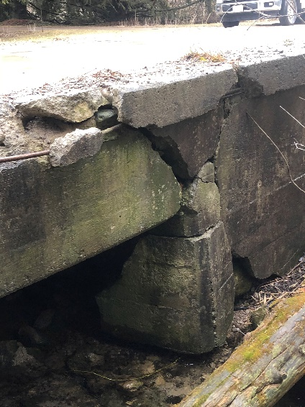
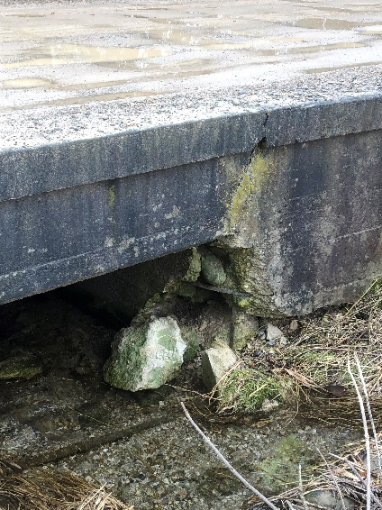
Public Works
Sixth Line Box Culvert Replacement
Non OSIM structure critical condition identified in 2020
Located on dead end road
Cost: $125,000
Funding from Public Works Bridge Reserves

Slide 29
Public Works
Backhoe Replacement
Unit 307 is a 2005 John Deere 310 backhoe
Estimated service life as per Fleet Replacement Policy is 12 years
High wear piece of equipment essential for summer maintenance and winter salt loading
Cost: $170,000
Funding from Public Works Equipment Reserves

Slide 30
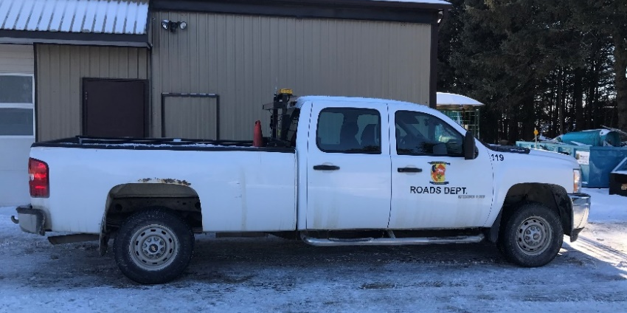
Public Works
Fleet Vehicle Replacement
Unit 121 is a 2011 model year with over 260,000 km’s
Fleet Replacement Policy outlines general life expectancy of 8 years; 200,000 km’s for pickup trucks
Cost: $50,000
Funding from Public Works Equipment Reserves

Slide 31
Public Works
Fleet Vehicle
New Fleet vehicle – approved in 2020 but deferred due to COVID
Growth related
New vehicle identified through Development Charges Background Study
Estimate Cost: $38,000
Funding from Development Charges

Slide 32
Water/Wastewater Capital Highlights
(Funded through User Fees)

Slide 33
Water and Wastewater
Proposed budget includes:
SCADA upgrades (water & wastewater)
Catherine Street railway watermain connection
Alma Street watermain replacement
Wellington Road 27 railway crossing servicing improvements (water & wastewater)
Ridge Road Sewage Pumping Station piping replacement
Sanitary inflow investigation – Rockwood smoke testing

Slide 34
Water and Wastewater
SCADA Upgrades
SCADA system road map report completed as part of 2018 capital budget
Proposed Multi Year Work Plan to upgrade overall system
Year two (2021) focuses on water facilities
Multi Year Plan included in 2020 Water & Wastewater Rate Study
Estimated Year 2021 cost: $100,000
Funding from Water Reserves

Slide 35
Water and Wastewater
SCADA Upgrades Cont.

Slide 36
Water and Wastewater
Catherine Street Railway Watermain Connection
Proposed 2nd watermain to Rockwood north of tracks
Provided redundancy for supply of water and fire protection to new development north of tracks with connection of watermain on Catherine Street to Rockmosa Drive
Approvals on-going with Metrolinx
Estimated cost: $430,000
Funding from Development Charges and Water Capital Reserves

Slide 37
Water and Wastewater
Alma Street Watermain Replacement
Replacement of approximately 170 m. of watermain along Alma Street (Inkerman to Pasmore)
Combined Project with Highway 7 improvements for proposed Alma Street commercial development
Eliminates numerous capped water services remaining from demolished properties along that section of Alma St.
Project contingent on commercial development moving forward.
Cost: $225,000
Funding from Water Reserves

Slide 38
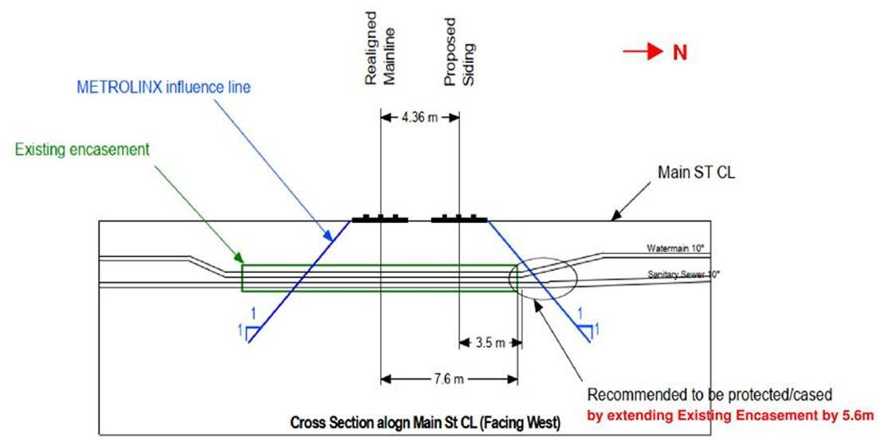
Water and Wastewater
Wellington Road 27 Railway Crossing Servicing Improvements
Metrolinx is twinning the existing track on the Guelph Corridor
Original servicing tunnel under rail was design and constructed under agreement in the 1970’s for a single track
Twin track requires extension of servicing tunnel
Project contingent on Metrolinx timing for twinning estimated to commence in 2021
Estimated Cost: $200,000
Funding from Water &
Wastewater Reserves

Slide 39
Water and Wastewater
Ridge Road Sewage Pumping Station Piping Replacement
Pumping station is over 20 years
Interior piping has deteriorated faster than expected due to conditions in wet well and pipe material
Life Cycle replacement of internal piping only
Included in 2020 Water/Wastewater Rate Study
Cost: $32,000
Funding from Wastewater Reserves

Slide 40
Water and Wastewater
Sanitary Inflow Investigation
Significant increases in sewage flow are recorded during wet weather periods and spring melt. This wet weather flow or extraneous flows must still be treated and is discharged to Guelph reducing the capacity available for development
North Rockwood completed in 2020, multi year program to continue for other areas of Rockwood
Smoke testing of the sanitary collection system is a simple way of identifying cross connection locations
Estimated cost: $30,000
Funding from Development Charges

Slide 41
Parks and Recreation Capital Highlights

Slide 42
Parks and Recreation
Proposed 2021 P&R Budget Includes the following Capital:
Replacement flooring at the RDAPC
Upgrade and expansion to network of video surveillance
Banquet Chair replacement at the Marden Community Centre
Commercial Dishwasher at the Older Adult Centre
Internet upgrade and Public Access Wi-Fi at Rockmosa
Valentino Play Structure replacement
72” Front deck mower replacement
Rockmosa development
Board walk Marden Park
Marden Ball diamond light pole replacement
Truck bed insert salt spreader
Picnic Table and waste receptacles
Lloyd Dyer Public washroom fascia and soffit
Sports field line painter

Slide 43
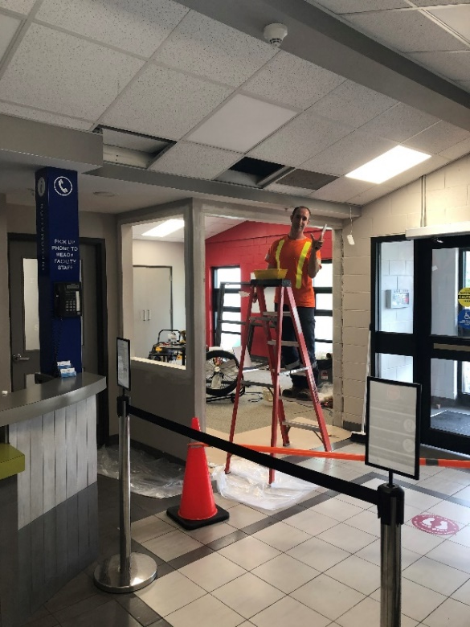
Parks and Recreation
Replacement Flooring at the RDAPC
This proposed project is to replace the flooring throughout the staff area of the facility as well as tile repair/replacement as a result of the relocation of the reception area.
Transfer from RDAPC Reserves $20,000

Slide 44
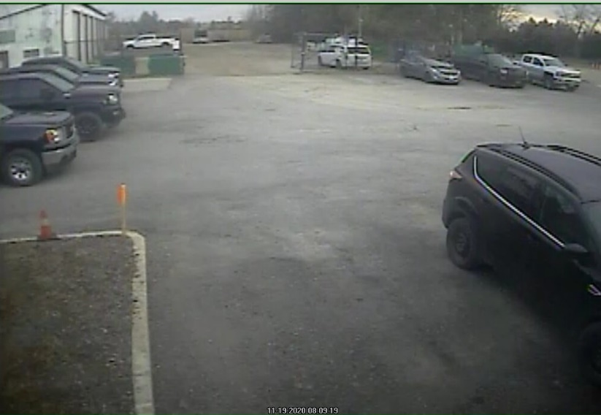
Parks and Recreation
Video Surveillance upgrades and expansion
Video surveillance is used for crime related activities, it also has been relied upon to defend against insurance claims and public complaints.
This project will upgrade the systems at Brucedale office, Rockmosa CC and the RDAPC as well as add additional monitoring at the Marden PW and Parks work shops.
Transfer from the modernization Fund $48,000

Slide 45
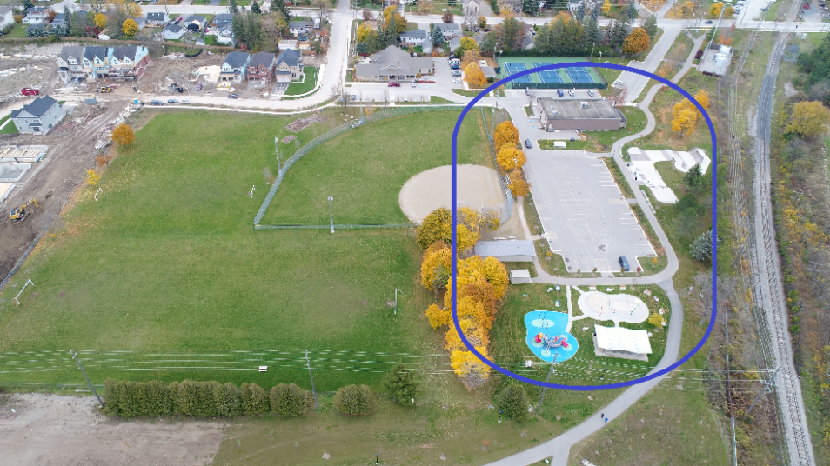
Parks and Recreation
Rockmosa Public Access Wi-Fi
This project proposes to bring high speed internet into the Rockmosa Community Centre by means of fiber optics. Once a fiber service is secured on the site it is proposed to broadcast public access Wi-Fi to the park amenities at Rockmosa Park.
Transfer from Modernization Fund: $13,000

Slide 46
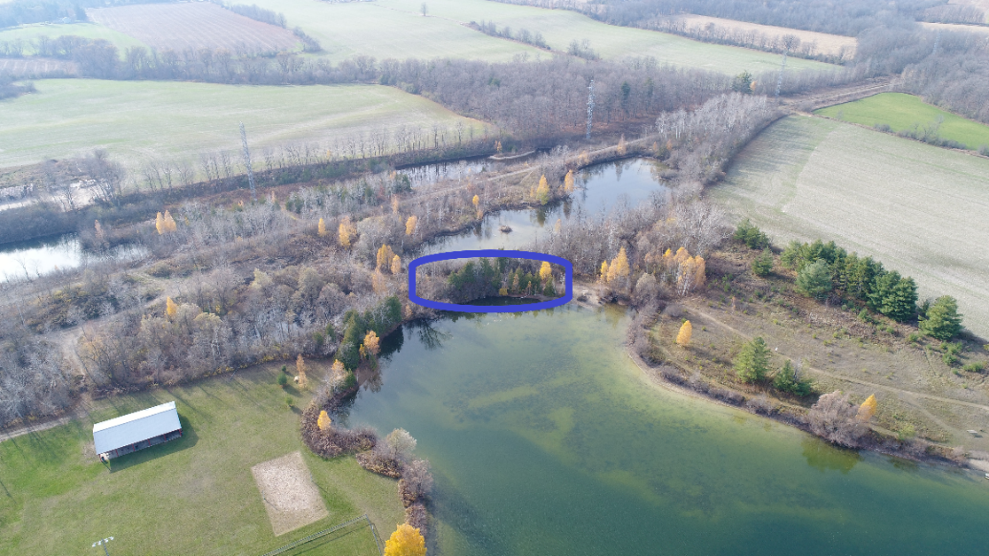
Parks and Recreation
Elevated Board Walk Marden Park
This proposed project is to install a 50‘ long elevated board walk at Marden Park. The board walk will be installed using helical piles with pressure treated decking to span an area of trail that is historically saturated.
Transfer from General Parks Reserve $12,000

Slide 47
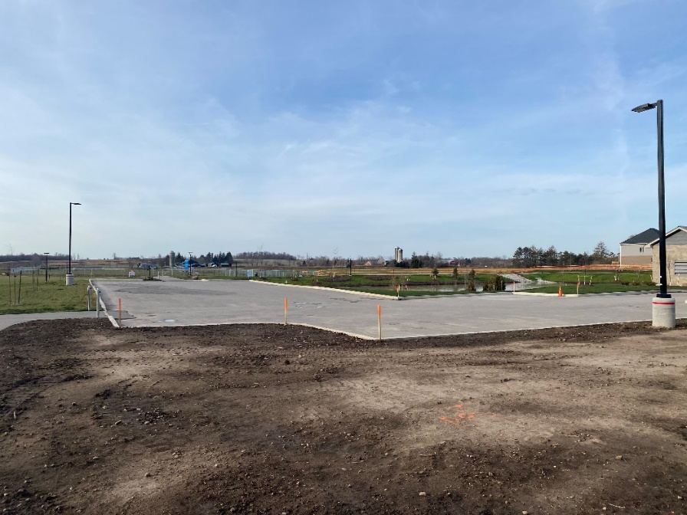
Parks and Recreation
Rockmosa Park Development
The application of wear course asphalt on the dog park parking lot is the last proposed project for the Rockmosa expansion and is a capital carry over item from the 2020 budget. The project is to be coordinated with the Bonarrow developer to be completed when the top lift of asphalt is applied to the internal road network of the Bonarrow development.
Transfer from Rate Stabilization $25,000

Slide 48
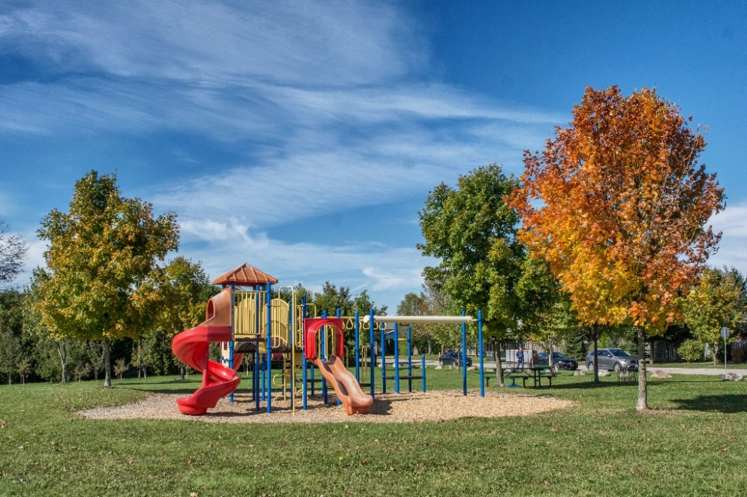
Parks and Recreation
Valentino Play Structure
The play structure at Valentino Park is 20 years old meeting our replacement life cycling for play structures, the playground manufacturer is no longer in operation and replacement parts for this structure are no longer available.
Transfer from Play Structure Replacement Reserve: $84,000

Slide 49
2021 Budget
SUMMARY
To fund municipal operations and capital initiatives, we are proposing a total budget of $18,253,333 for 2021.
To continue to support the sustainability of our infrastructure, we have included $269,000 in dedicated reserves funds for infrastructure renewal.
We will collect $11,090,731 in revenues from user fees, penalty and interest and funding for capital through development charges and reserves.

Slide 50
2021 Budget
SUMMARY
$180,000 from the Provincial Safe Restart funding and rate stabilization will be used to offset the additional costs and lost revenue resulting from the COVID-19 Pandemic.
$123,500 new tax revenue will be generated from additional assessment due to growth.
As presented today, additional property taxes are not required to fund the 2021 proposed budget.

Slide 51
2021 Budget
2021 Proposed Tax Levy Change
Prior Year's Taxation Levy | $7,308,102.00
Add: Assessment Growth | $ 123,500.00
Total Taxation Levy With Growth | $7,431,602.00
Total Taxation Requirements | $7,431,602.00
$ Increase | $ 0.00 | 0.0%

Slide 52
2021 Budget
Proposed Tax Impact on Residential Properties
The COVID-19 Pandemic has placed financial hardship on many people in Ontario including the residents and businesses within the Township of Guelph/Eramosa.
The proposed budget as presented today proposes a 0% increase in property taxes to support the services provided by the Township.

Slide 53
24/7 365 ACCESS TO FIRE AND EMERGENCY SERVICES
SNOW PLOWING AND WINTER ROAD MAINTENANCE
$151 MILLION IN BUILDINGS, ROADS, BRIDGES AND VEHICLES
225 KM OF ROADS SIDEWALK PLOWING AND MAINTENANCE
TREE REMOVAL AND REPLACEMENT ROAD MAINTENANCE
SHOULDERING DITCHING EMERGENCY MANAGEMENT
FIRE SAFETY EDUCATION ACTIVE 55+ FITNESS PROGRAM
DUST CONTROL ROADSIDE LITTER PICK-UP
RURAL ROADSIDE SPRAYING CROSSING GUARDS
11 PLAY STRUCTURES RECREATION PROGRAMS
7 COMMUNITY FACILITIES SPLASH PAD 6.6 KM OF TRAILS
82 HECTARES OF OPEN SPACE 14 PARKS
1 STATE-OF-THE-ART INDOOR SPORTS FIELD COMMUNITY GUIDE
TURF MANAGEMENT OF 12 SPORTS FIELDS
ROADSIDE MOWING STREET SWEEPING ECONOMIC DEVELOPMENT
ELECTIONS CULVERT REPLACEMENTS OUTDOOR ICE RINKS
COMMUNITY EVENTS LINE PAINTING WINTER ROAD PATROLLING
BY-LAW ENFORCEMENT PROPERTY STANDARDS ENFORCEMENT

